Slide 1


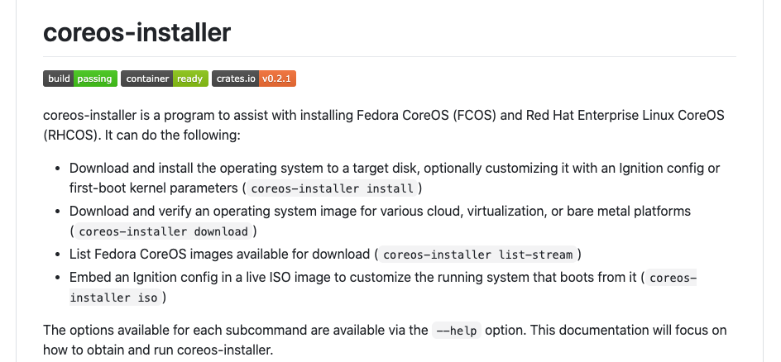
Preserve Partition Enhancement GRPA-1894
Glenn West
gwest@redhat.com

Slide 2
Overview
Usage of local storage in ocp and cnv is increasing
Common to put both os and user data on one device
RAID and nvme
Often local storage performance is multiple orders of magnitude higher than network attached storage
Data Sizes can be so large that it is close to impossible to move/copy data to install/reinstall

Slide 3
Tail Of Two Installers
RHCOS/OCP version prior to 4.6 use legacy installer
Implemented in Bash script
Legacy Branch on Github
RHCOS/OCP 4.6 and later use a new RUST based installer
Master Branch on Github

Slide 4
Starting Point (4.6) – Coreos Installer
Current RHCOS Installer owns 100% of primary disk
Existing Partition Table is copied over
No Data is preserved
On failure for any reason, partition table is deleted

Slide 5
New Functionality (4.6) – CoreOS Installer
Read existing partitions, and find user partitions
Let the install continue
On completion or error, restore user partitions

Slide 6
Definition of User Partitions
RHCOS effectively creates 4 partitions
This is done by copying a “image” that contains partition table and all content.
The new installer does have platform specific components that do understand partitions (OS360)
User partitions are identified as any partition > 4.
A disk with a single partition, such as sda5 for example, would be preserved
All assumes gpt based partitioning, with no regard for source OS. RHEL/RHCOS or Debian
No data movement is done
Data must be exist > 200 Meg above start of disk to be preserved

Slide 7
Change of preserve-on-error
Change --preserve-on-error to –clear-on-error
New default is to preserve existing partitions, so need a hard parameters to force the clear
Git commit: 3d7635a

Slide 8
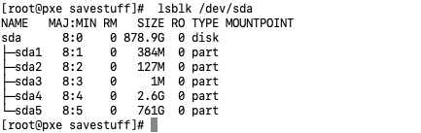
Test Case 5p
Test case – 5 Partitions
One preserved partition after rhcos

Slide 9
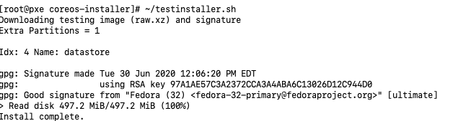
Add Support to find extra gpt partitions
Saving Partitions only for gpt based disk
If partition > 4, then partition is viewed as savable
Currently idx is 1 less than partition number
Git Commit: e3e617e

Slide 10
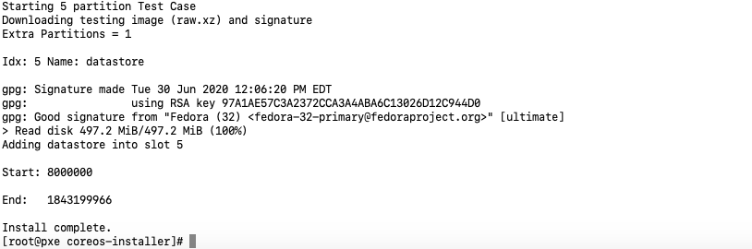
Restore Additional Partitions
After install, restore any additional partitions
On install error, preserve any additional partitions
Git Commit: a7544a9

Slide 11
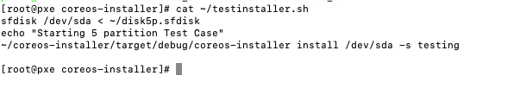
Test Script
Use sfdisk to laydown a starting partition (Capture from a running system)
Run the modified installer, and verify results

Slide 12
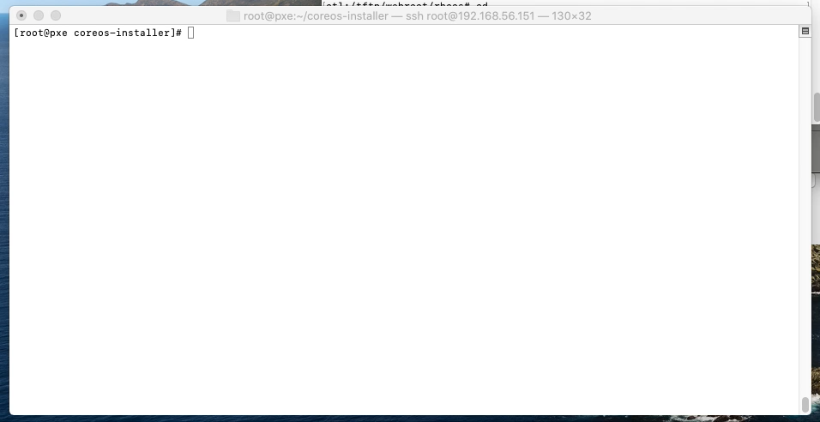

Slide 13
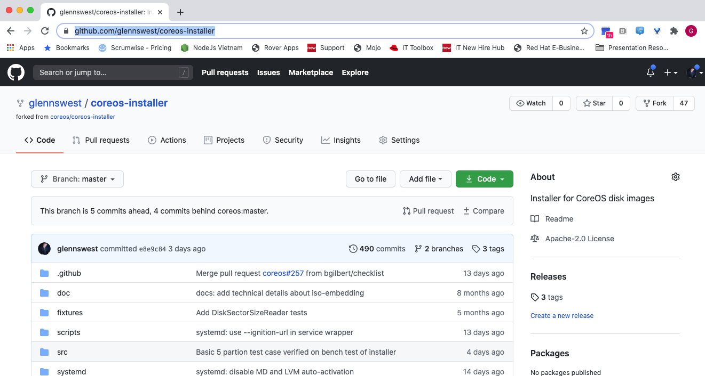
Where is it:
https://github.com/glennswest/coreos-installer

Slide 14
To Do
More Testing
Full install on single machine pxe - In progress
Full ocp install
Code Review on failure paths
PR

